Slide 1
Chapter 6 Implementing Basic Ethernet LANs
Liu Cui

Slide 2
To create an Ethernet LAN, a network engineer starts by planning.
They consider the requirements
Create a design
Buy the switches
Contract to install cables
Configure the switches to use the right features

Slide 3
CCENT and CCNA Routing and Switching Exams
Focus:
Skills like understanding how LANs work
Configuring different switch features
Verifying that those features work correctly
Finding the root cause of the problem when a feature is not working correctly
The First Skill: Lean how to access and use the user interface of the switch
The user interface of the switch is called the command-line interface (CLI).

Slide 4
Topics in this Chapter
Accessing the Cisco Catalyst Switch CLI

Slide 5
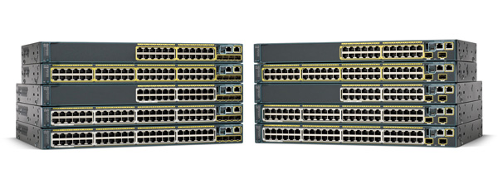
Cisco Catalyst Switches
Within the Cisco Catalyst brand of LAN switches, Cisco produces a wide variety of switch series or families. Each switch series includes several specific modesl of switches that have similar features, similar price-versus-performance trade-offs, and similar internal components.
Cisco refers to a switch’s physical connectors as either interfaces or ports, with an interface type and interface number.

Slide 6
Accessing the Cisco IOS CLI
Like any other piece of computer hardware, Cisco switches need some kind of operating system software. Cisco calls this OS the Internetwork Operating System (IOS).
Cisco IOS software for Catalyst switches implements and controls logic and functions performed by a Cisco switch.
Besides controlling the switch’s performance and behavior, Cisco IOS also defines an interface for humans called the CLI.
The Cisco IOS CLI allows the user to use a terminal emulaion program, which accepts text entered by the user.

Slide 7
Accessing the Cisco IOS CLI
CLI is a text-based interface in which the user enters a text command and presses Enter.
Pressing Enter sends the command to the switch, which tells the device to do something.
The switch does what the command says, and in some cases, the switch replies with some messages stating the results of the command.
Cisco Catalyst switches also support other methods to both monitor and configure a switch.

Slide 8
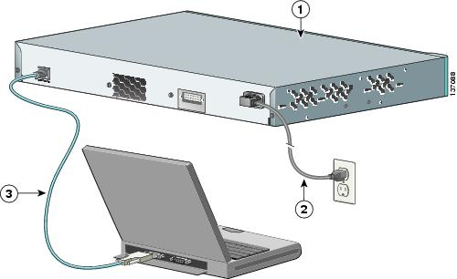
Accessing the Cisco IOS CLI
The switch CLI can be accessed through three popular methods:
The console,
Telnet, and
Secure Shell (SSH)
Telnet and SSH use the IP network in which the switch resides to reach the switch.
The console is a physical port built specifically to allow access to the CLI.

Slide 9
User and Enable (Privileged) Modes
All three CLI access methods covered place the user in an area of the CLI called user EXEC mode.
User EXEC mode, sometimes also called user mode, allows the user to look around but not break anything.
Cisco IOS supports a more power EXEC model called enable mode (also known as privileged mode or privileged EXEC mode).
Enable mode gets its name from the enable command, which moves the user from user mode to enable mode.
Under enable mode, you can use the reload command, which tells the switch to reinitialize or reboot Cisco IOS.

Slide 10
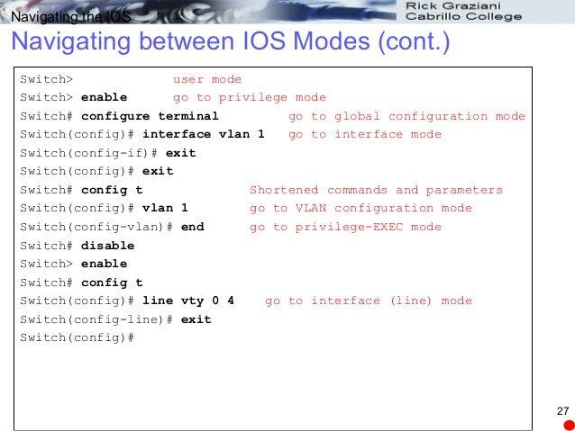
User and Enable (Privileged) Modes

Slide 11
Configuring Cisco IOS Software
Configuration mode is another mode for the Cisco CLI.
User mode lets you issue non-disruptive commands and displays some information.
Privileged mode supports a superset of commands, including commands that might disrupt switch operations.
However, none of the commands in user or privileged mode changes the switch's configuration.

Slide 12
Configuring Cisco IOS Software
Configuration mode accepts configuration commands –commands that tell the switch the details of what to do and how to do it.
Commands entered in configuration mode update the active configuration file. These changes to the configuration occur immediately each time you press the Enter key at the end of a command.

Slide 13
Configuration Submodes and Contexts
Configuration mode itself contains a multitude of commands. To help organize the configuration, IOS groups some kinds of configuration commands together.
To do that, when using configuration mode, you move from the initial mode –global configuration model –into subcommand modes.
Context-setting commands, such as interface, move you from one configuration subcommand mode to another.
Document: http://www.cisco.com/c/en/us/td/docs/switches/lan/catalyst3750/software/release/12-2_55_se/commmand/reference/3750cr/intro.html
Youtube: https://www.youtube.com/watch?v=QNycDKAihGk

Slide 14
Storing Switch Configuration Files
When you configure a switch, it needs to use the configuration.
It also needs to be able to retain the configuration in case the switch loses power.
Random Access Memory (RAM): working storage like computer. It loses its contents when the switch loses power or is reloaded.
Flash memory: either a chip inside the switch or a removable memory card, flash memory stores fully functional Cisco IOS images and is the default location where the switch gets its Cisco IOS at boot time. Flash memory also can be used to store any other files, including backup copies of configuration files.

Slide 15
Storing Switch Configuration Files
Read Only Memory (ROM): stores a bootstrap program that is loaded when the switch first powers on. This bootstrap program then finds the full Cisco IOS image and manages the process of loading Cisco IOS into RAM, at which point Cisco IOS takes over operation of the switch.
Nonvolatile RAM (NVRAM): stores the initial or startup configuration file that is used when the switch is first powered on and when the switch is reloaded.
Cisco IOS stores the collection of configuration commands in a configuration file. In fact, switches use multiple configuration files –one file for the initial configuration used when powering on, and another configuration file for the active, currently used running configuration as stored in RAM.
Essentially, when you use configuration mode, you change only the running-config file.

Slide 16
Copying and Erasing Configuration Files
The configuration process updates the running-config file, which is lost if the router loses power or is reloaded. Clearly, IOS needs to provide us a way to copy the running configuration so that is will not be lost, so it will be used the next time the switch reloads or powers on.
For example, the EXEC command copy running-config startup-config backs up the running-config to the startup-config file. This command overwrites the current startup-config file with what is currently in the running-configuration file.

